Slide 1
An Exploratory Analysis of Asteroid Impacts
By Jonathan Shea, Albert Magpoc, and Mina Fahim

Slide 2
Introduction
Collected by NASA’s Sentry Collision Monitoring System
683 Asteroids with potential impacts
15,635 Asteroids orbit information
Asteroids grouped into small number of classes
Questions
Which class of asteroid poses the greatest risk?
What is the distance to earth of dangerous v. non-dangerous asteroids?
How do the number of potential impacts change over time?

Slide 3
Data Importing and Tidying
Imported as two separate .csv files
Combined based off of name
Had to clean name up
237551 (2000 WQ19) vs. 2000 WQ19 vs. WQ19
Added dummy values for impact columns to non-hazardous asteroids
Split rows into key-value pairs for year-num_impacts_per_year
Asteroid Name | Year | Impacts per Year
WQ19 | 2017 | 2
WQ19 | 2018 | 2
WQ19 | 2019 | 2
Asteroid Name | Start Year | End Year | Potential Impacts
WQ19 | 2017 | 2019 | 6

Slide 4
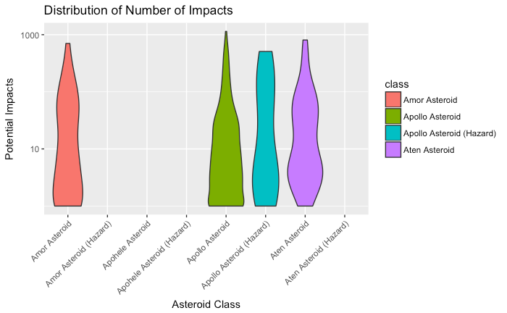
Most Dangerous Asteroid Classes
Analyze the distribution of potential impacts and impact threat for each class of Asteroid
Scale threat value to positive range for use with logarithmic scale axis

Slide 5
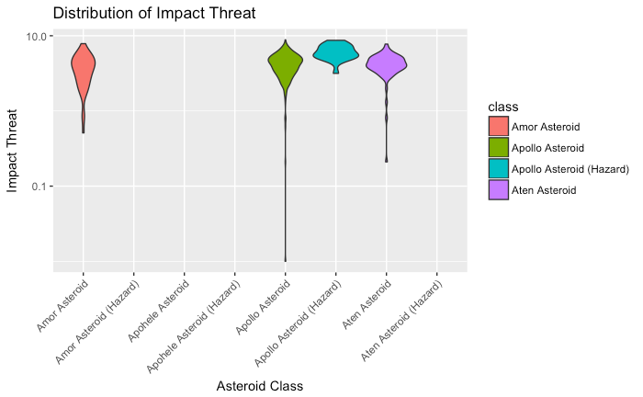
Most Dangerous Asteroid Classes (cont)

Slide 6
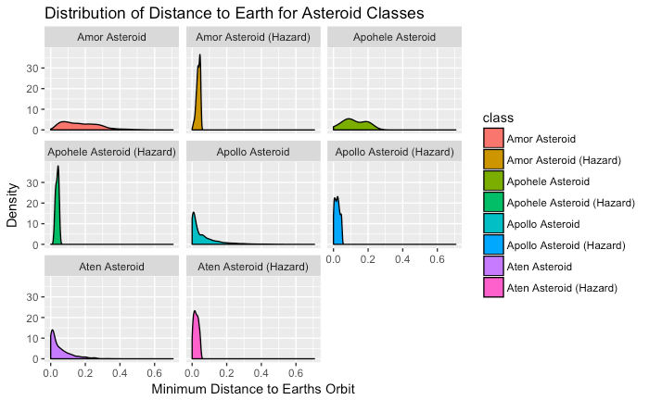
Distance to Earth for Hazardous Asteroids
Compare the distances of each asteroid class to the orbit of the Earth
Gain insight into how classes are deemed hazardous or not
Not all close asteroids are hazardous

Slide 7
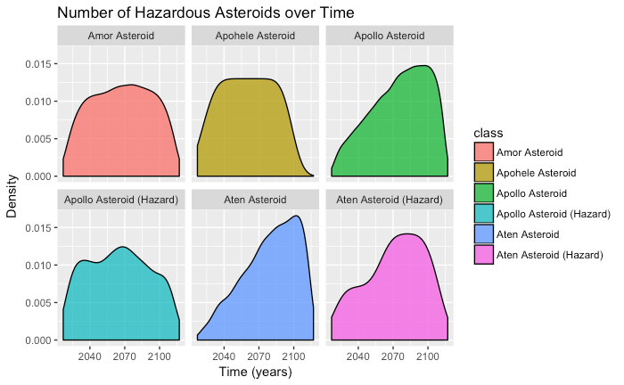
Impact Threat over Time
Plot the distribution of hazardous asteroids over time

Slide 8
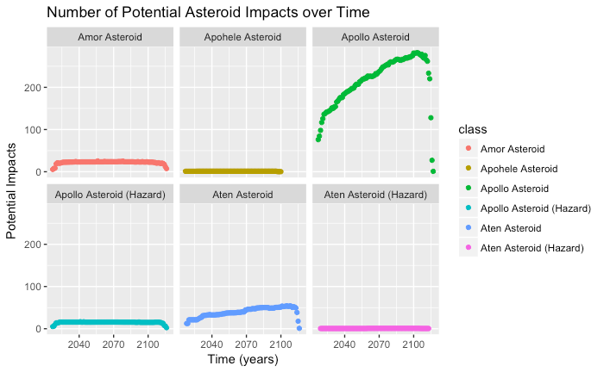
Impact Threat over Time (cont)
Plot the number of potential impacts over time

Slide 9
Summary
Lessons Learned
Apollo class asteroids pose the greatest threat
Number of potential impacts growing over time
Drawbacks
Data is for a short period of time, so trends difficult to confirm
Yearly impacts are a large approximation

Slide 10
References
Possible Asteroid Impacts with Earth - NASA
https://www.kaggle.com/nasa/asteroid-impacts

